Slide 1
Statistical Software Quality Assurance

Slide 2
Statistical SQA is a technique that measures the quality in a quantitative fashion.
It implies that information about defects is collected and categorized and an attempt is made to trace each defect to underlying cause.
It uses Pareto Principle to identify vital causes
80% of defects can be traced to 20% of causes

Slide 3
Category of Defects
1. Incomplete or erroneous specifications (IES)
2. Misinterpretation of customer communication (MCC)
3. Intentional deviation from specifications (IDS)
4. Violation of programming standards (VPS)
5. Error in data representation (EDR)
6. Inconsistent component interface (ICI)
7. Error in digital logic (EDL)
8. Incomplete or erroneous testing (IET)
9. Inaccurate or incomplete documentation (IID)
10. Error in programming language translation of design (PLT)
11. Ambiguous or inconsistent Human Computer Interface (HCI)
12. Miscellaneous (MIS)

Slide 4
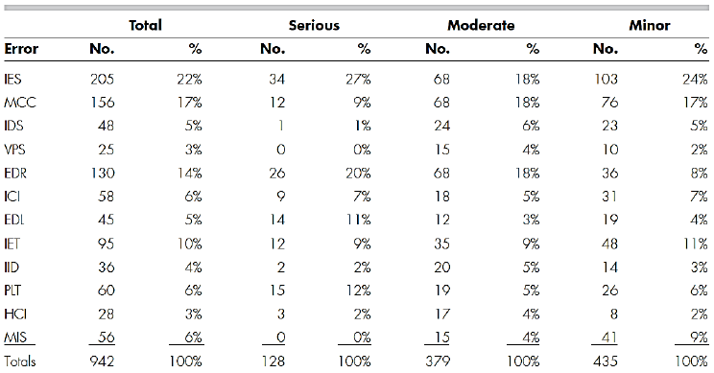

Slide 5
Error Index (EI)
Another statistical technique known as Error Index (EI) is used to develop an overall indication of improvement in software quality. The EI is computed as follows:
Ei – the total number of errors uncovered during the ith step in the SE process
Si – number of serious errors
Mi – number of moderate errors
Ti – number of minor errors
PS – product size at the ith step
ws, wm, wt – weighting factors for serious, moderate, and minor errors.
Recommended values for these are 10, 3, 1 respectively.

Slide 6
Phase Index is computed as
PIi = ws(Si/Ei) + wm(Mi/Ei) + wt(Ti/Ei)
EI is computed as the cumulative effect on each Pii
EIi = Σ(I x PIi)/PS

Slide 7
Software Reliability
Software reliability is another very important quality factor and is defined as probability of failure free operation of a computer program in a specified environment for a specified time.

Slide 8
The reliability of software is determined by
Mean time between failure (MTBF). MTBF is calculated as:
MTBF = MTTF + MTTR
MTTF is the Mean Time to Failure and
MTTR is the Mean time required to Repair.
Availability = (MTTF/MTBF) x 100

Slide 9
CMMI
CMM was developed by the Software Engineering Institute (SEI) at Carnegie Mellon University in 1987.
It is not a software process model. It is a framework that is used to analyze the approach and techniques followed by any organization to develop software products.
It also provides guidelines to further enhance the maturity of the process used to develop those software products.

Slide 10
It is based on profound feedback and development practices adopted by the most successful organizations worldwide.
This model describes a strategy for software process improvement that should be followed by moving through 5 different levels.
Each level of maturity shows a process capability level. All the levels except level-1 are further described by Key Process Areas (KPA’s).

Slide 11
Objectives of CMMI
Fulfilling customer needs and expectations.
Value creation for investors/stockholders.
Market growth is increased.
Improved quality of products and services.
Enhanced reputation in Industry.

Slide 12
CMMI Representation – Staged and Continuous
Staged Representation :
  uses a pre-defined set of process areas to define improvement path.
  provides a sequence of improvements, where each part in the sequence serves as a foundation for the next.
  an improved path is defined by maturity level.
  maturity level describes the maturity of processes in organization.
  Staged CMMI representation allows comparison between different organizations for multiple maturity levels.

Slide 13
Continuous Representation :
  allows selection of specific process areas.
  uses capability levels that measures improvement of an individual process area.
  Continuous CMMI representation allows comparison between different organizations on a process-area-by-process-area basis.
  allows organizations to select processes which require more improvement.
  In this representation, order of improvement of various processes can be selected which allows the organizations to meet their objectives and eliminate risks.

Slide 14
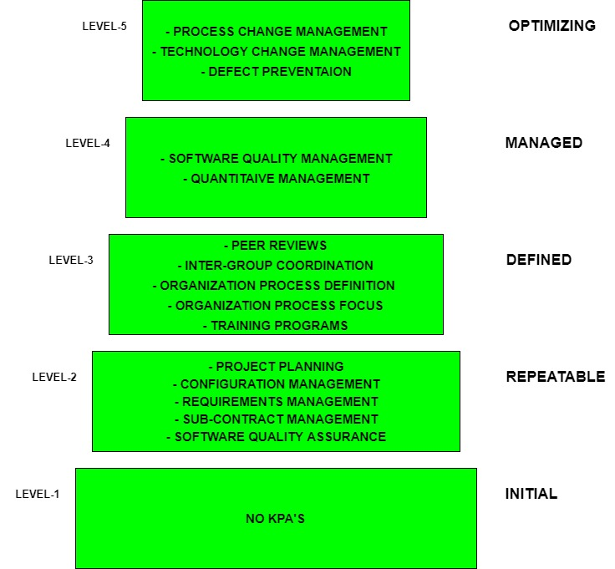

Slide 15
Level-1: Initial
No KPA’s defined.
Processes followed are Adhoc and immature and are not well defined.
Unstable environment for software development.
No basis for predicting product quality, time for completion, etc.

Slide 16
Level-2: Repeatable –
Focuses on establishing basic project management policies.
Experience with earlier projects is used for managing new similar natured projects.
Project Planning- It includes defining resources required, goals, constraints, etc. for the project. It presents a detailed plan to be followed systematically for the successful completion of good quality software.
Configuration Management- The focus is on maintaining the performance of the software product, including all its components, for the entire lifecycle.
Requirements Management- It includes the management of customer reviews and feedback which result in some changes in the requirement set. It also consists of accommodation of those modified requirements.
Subcontract Management- It focuses on the effective management of qualified software contractors i.e. it manages the parts of the software which are developed by third parties.
Software Quality Assurance- It guarantees a good quality software product by following certain rules and quality standard guidelines while developing.

Slide 17
Level-3: Defined
At this level, documentation of the standard guidelines and procedures takes place.
It is a well-defined integrated set of project-specific software engineering and management processes.
Peer Reviews- In this method, defects are removed by using a number of review methods like walkthroughs, inspections, buddy checks, etc.
Intergroup Coordination- It consists of planned interactions between different development teams to ensure efficient and proper fulfillment of customer needs.
Organization Process Definition- Its key focus is on the development and maintenance of the standard development processes.
Training Programs- It focuses on the enhancement of knowledge and skills of the team members including the developers and ensuring an increase in work efficiency.

Slide 18
Level-4: Managed
At this stage, quantitative quality goals are set for the organization for software products as well as software processes.
The measurements made help the organization to predict the product and process quality within some limits defined quantitatively.
Software Quality Management- It includes the establishment of plans and strategies to develop quantitative analysis and understanding of the product’s quality.
Quantitative Management- It focuses on controlling the project performance in a quantitative manner.

Slide 19
Level-5: Optimizing
This is the highest level of process maturity in CMM and focuses on continuous process improvement in the organization using quantitative feedback.
Use of new tools, techniques, and evaluation of software processes is done to prevent recurrence of known defects.
Process Change Management- Its focus is on the continuous improvement of the organization’s software processes to improve productivity, quality, and cycle time for the software product.
Technology Change Management- It consists of the identification and use of new technologies to improve product quality and decrease product development time.
Defect Prevention- It focuses on the identification of causes of defects and prevents them from recurring in future projects by improving project-defined processes.

Slide 20
ISO 9000 Standards in Software Engineering
The International organization for Standardization is a world wide federation of national standard bodies. The International standards organization (ISO) is a standard which serves as a for contract between independent parties. It specifies guidelines for development of quality system.
Quality system of an organization means the various activities related to its products or services. Standard of ISO addresses to both aspects i.e. operational and organizational aspects which includes responsibilities, reporting etc. An ISO 9000 standard contains set of guidelines of production process without considering product itself.

Slide 21
Why ISO Certification for Software Industry?
This certification has become a standards for international bidding.
It helps in designing high-quality repeatable software products.
It emphasis need for proper documentation.
It facilitates development of optimal processes and total quality measurements.

Slide 22
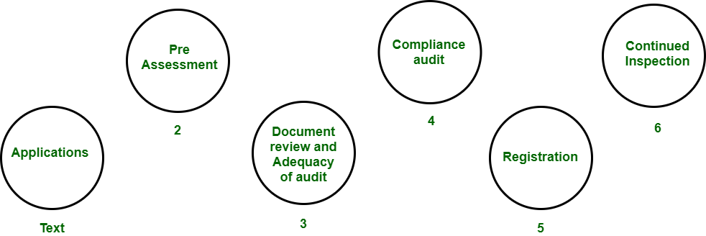

Slide 23
Features of ISO 9001 Requirements
Document control
All documents concerned with the development of a software product should be properly managed and controlled.
Planning
Proper plans should be prepared and monitored.
Review
For effectiveness and correctness all important documents across all phases should be independently checked and reviewed .
Testing
The product should be tested against specification.
Organizational Aspects
Various organizational aspects should be addressed e.g., management reporting of the quality team.

Slide 24
Advantages of ISO 9000 Certification
ISO-9000 certification forces a corporation to specialize in “how they are doing business”. Each procedure and work instruction must be documented and thus becomes a springboard for continuous improvement.
Employees morale is increased as they’re asked to require control of their processes and document their work processes
Better products and services result from continuous improvement process.
Increased employee participation, involvement, awareness and systematic employee training are reduced problems.

